Slide 1

Predictive Structures for Academic Success Testing pro

Slide 2
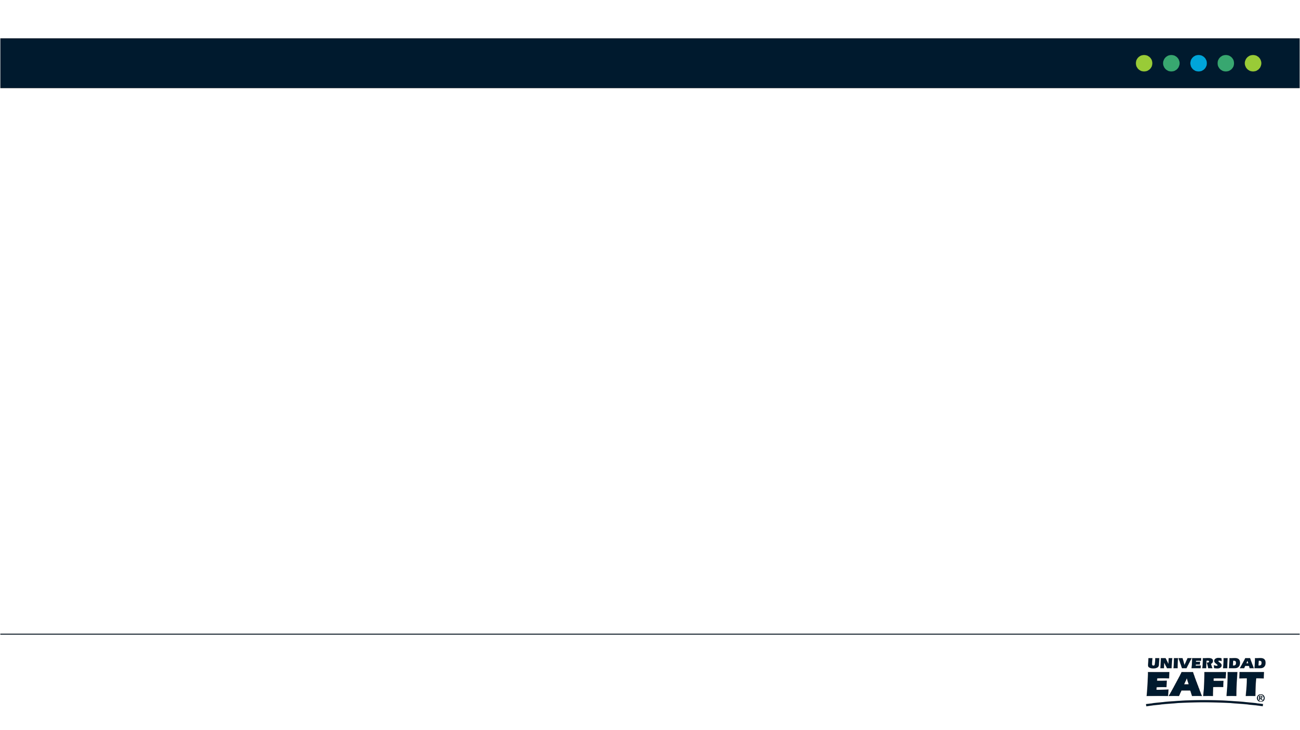
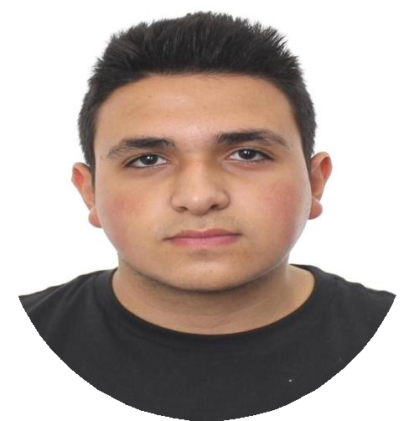
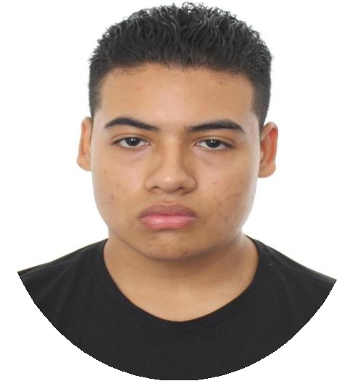
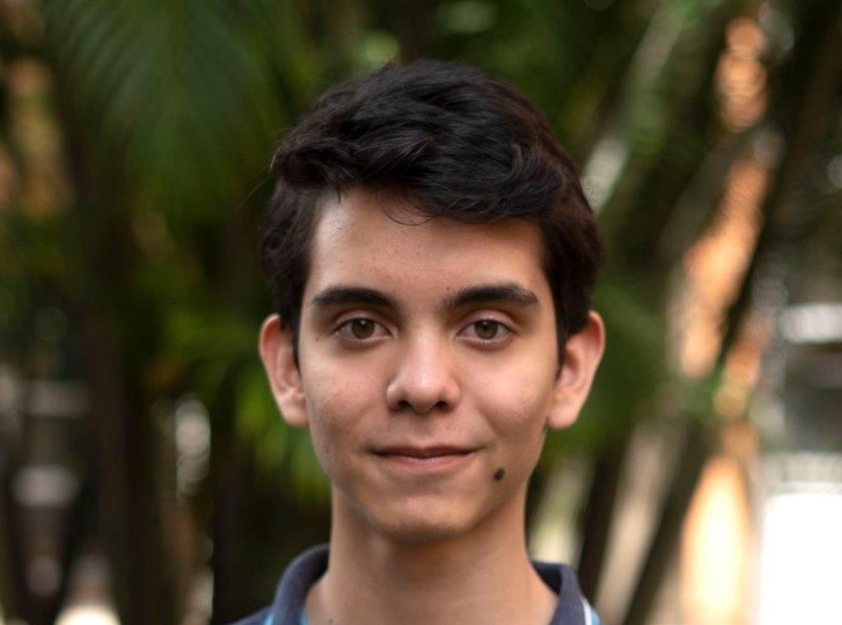
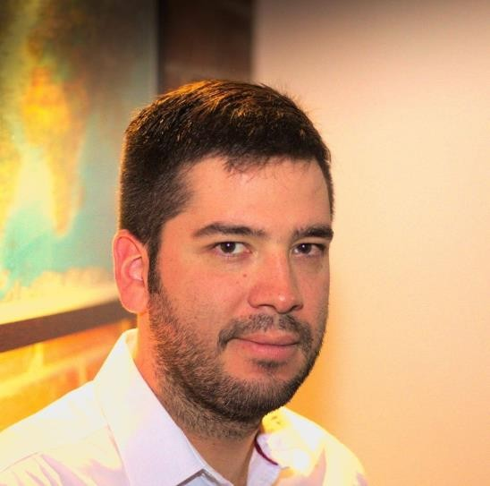

Team presentation
Tomás
Marin
Juan
Vera
Miguel
Correa
Mauricio
Toro
https://github.com/Vera3588/ST0245-001/tree/master/proyecto

Slide 3
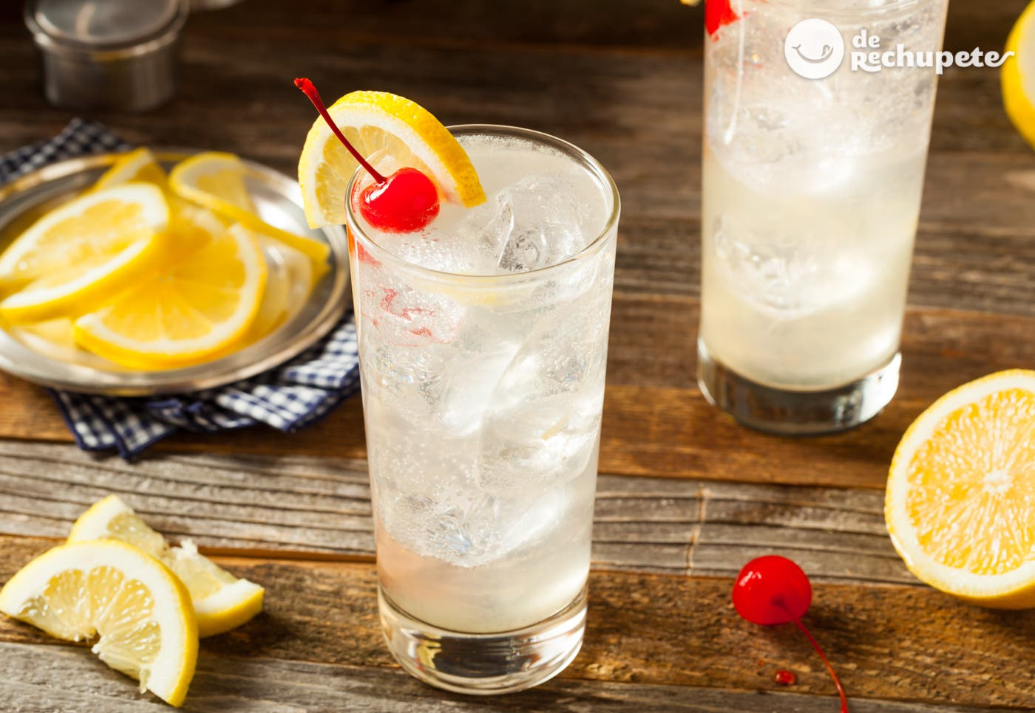
Coctel
TOM COLLINS

Slide 4
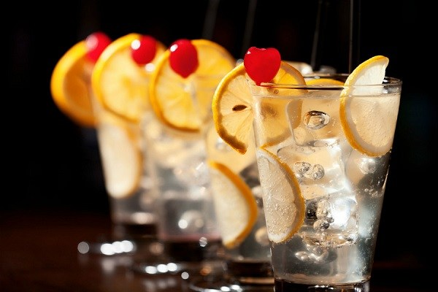
Coctel
Ingredients:
60 milliliters of gin
30 milliliters of lemon juice
1 teaspoon of sugar
soda (carbonated water, siphon or soda)
slices of lemon and mint for decoration.
This drink is from before the invention of soft drinks and in this case, it is suggested to use Old Tom Gin, since it provides more flavor.

Slide 5
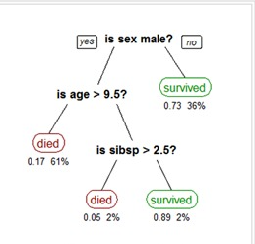
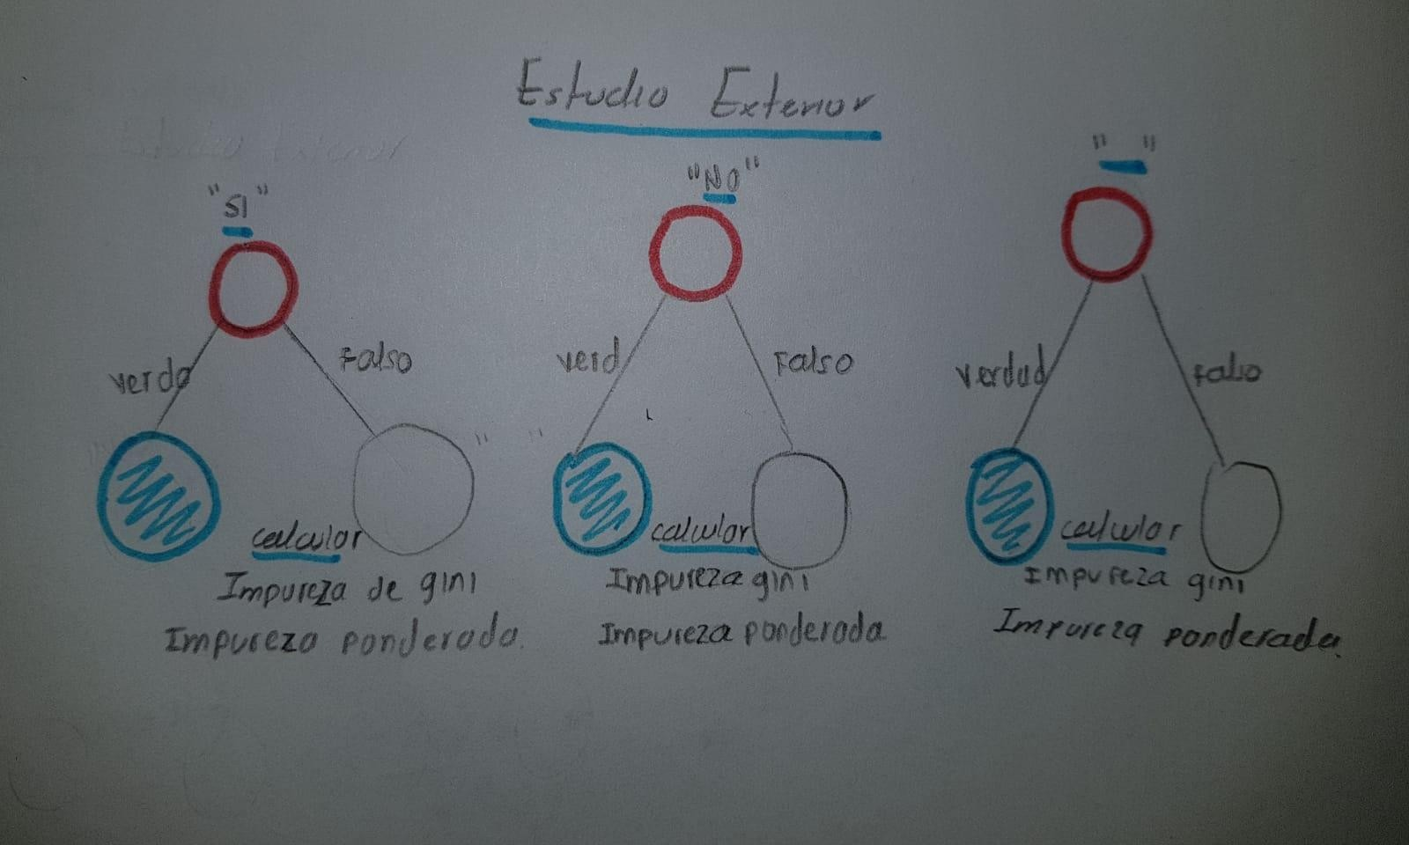
Algorithm design
The data structure we are going to use for this project is a
CART decision tree which will help us to predict
test results by taking several variables that affect
students.

Slide 6
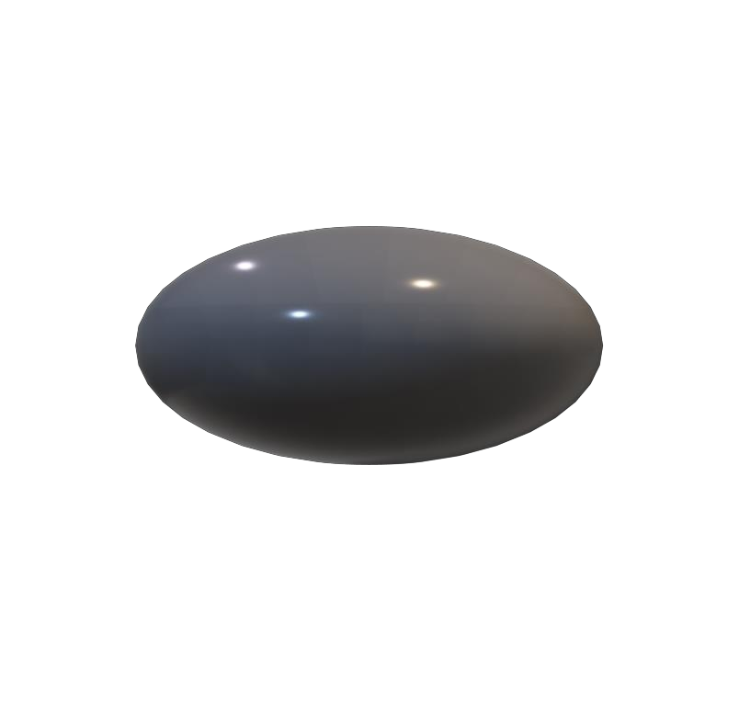


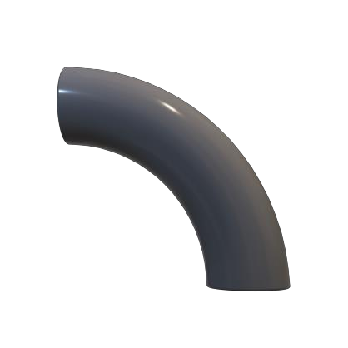

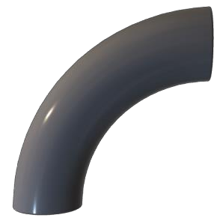
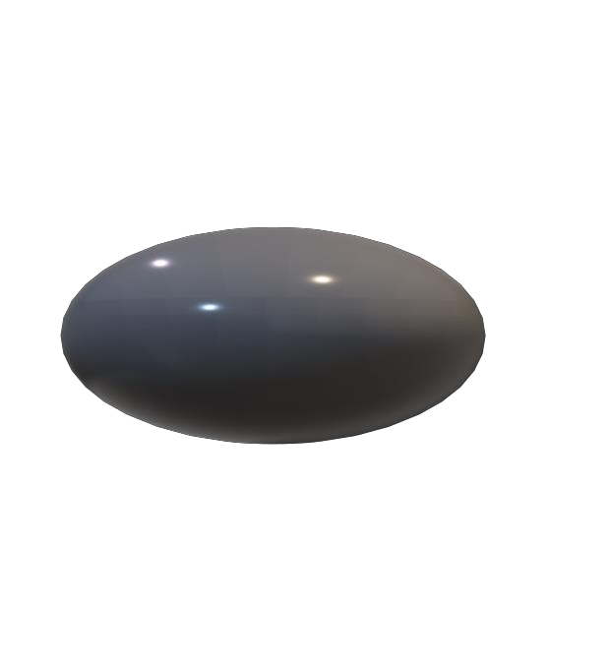
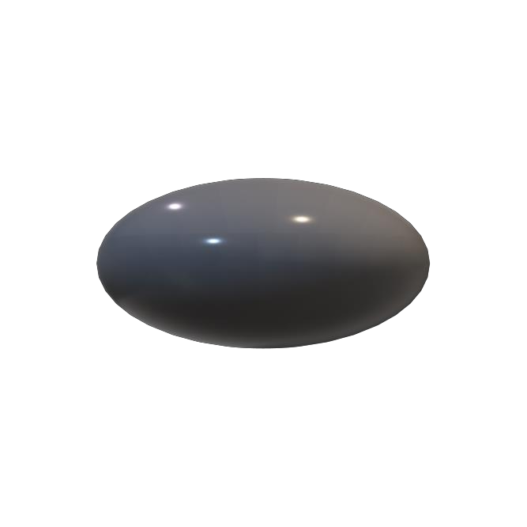
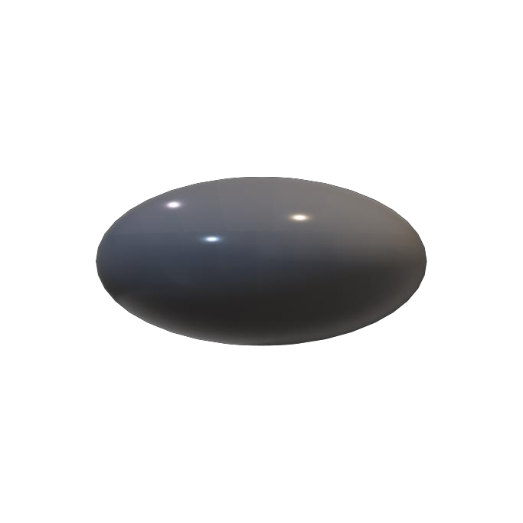
n de un nodo
Division
División
This division is based on “Estrato == 3" in this case, the
Gini impurity on the left equals 0.74, the Gini impurity on the right equals 0.27 and the weighted impurity is 0.39
.
This division is based on "simulacrotipoicfes == SI" in this case, the Gini impurity on the left equals 0.9, the Gini impurity on the right equals 0.08 and the weighted impurity is
0.16.

Slide 7
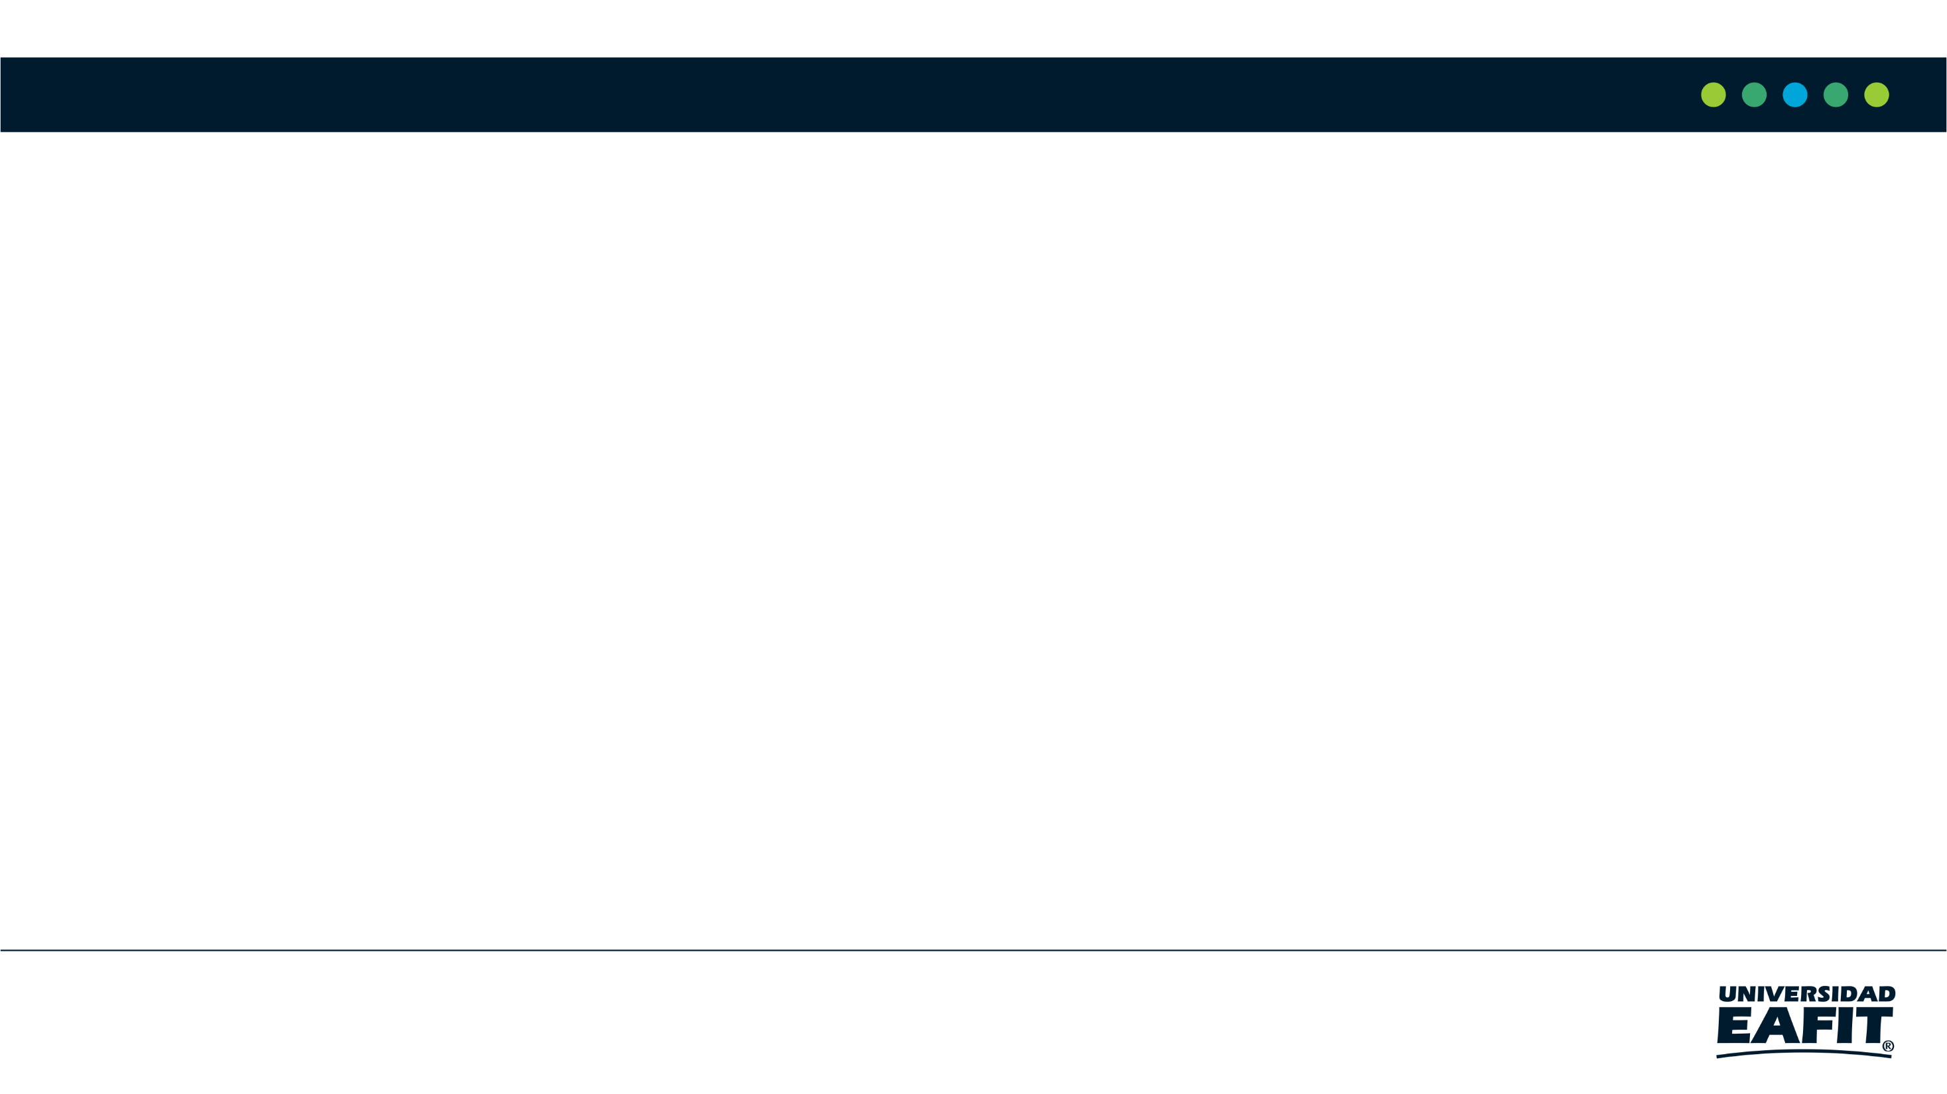

Complexity of the Algorithm
 | Time complexity | Complexity in memory
Model training | O(N*2^{M}) | O(N*M*2^{M})
Model validation | O(N*M) | O(N)
The complexity is this, because it would be the number of rows per column and as each floor has 2 nodes minimum then it would be 2 at m.
N being the rows.
M being the columns.

Slide 8




Decision Tree Model
Score English( >= -A)
Most Relevant Features
false
true
Internet
School
English
Gender
Resident
false
true
No Oficial
Oficial
Gini : 0.3
Gini : 0.15
A decision tree to predict the outcome of Saber Pro using the results of Saber 11. Blue represents nodes with high probability of success; green medium probability; and red low probability.

Slide 9
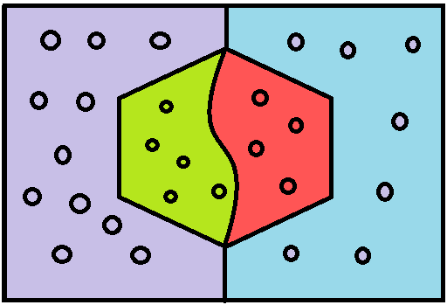
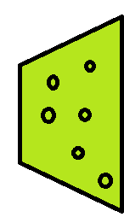
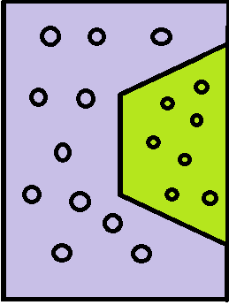
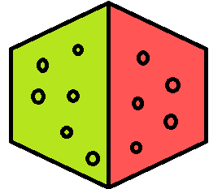
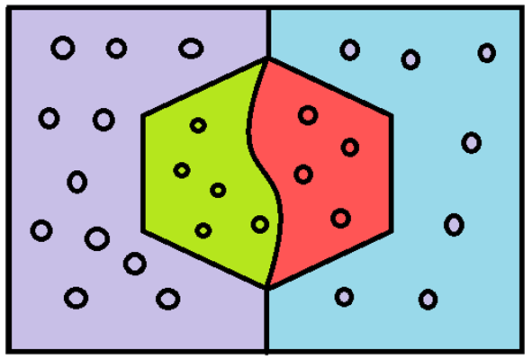
Evaluation Metrics
Recall =
Accuracy =
False negatives
True negatives
Exactly =
True positives
False positives

Slide 10

Evaluation Metrics
 | Training Set | Validation set
Exactly | 0.7 | 0.6
Accuracy | 55.5% | 54%
Recall | 0.6 | 0.5
Evaluation metrics obtained with the training data set of 135,000 students and the validation data set of 45,000 students

Slide 11


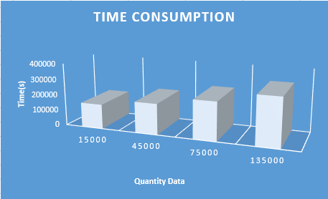
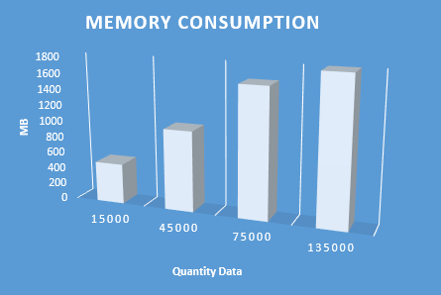
Time and Memory consumption

Slide 12

For your attention

